Slide 1
Hyperelastic Anisotropic Fiber-reinforced rubber composite ML-based constitutive modeling
Tanzeela Anum
10035246

Slide 2
Contents
Introduction ​
Motivation​
Approach
Physical Constraints
By-Design Strategy
ICNN​
FNN​
Hyperparameter Tuning​
Conclusion ​

Slide 3
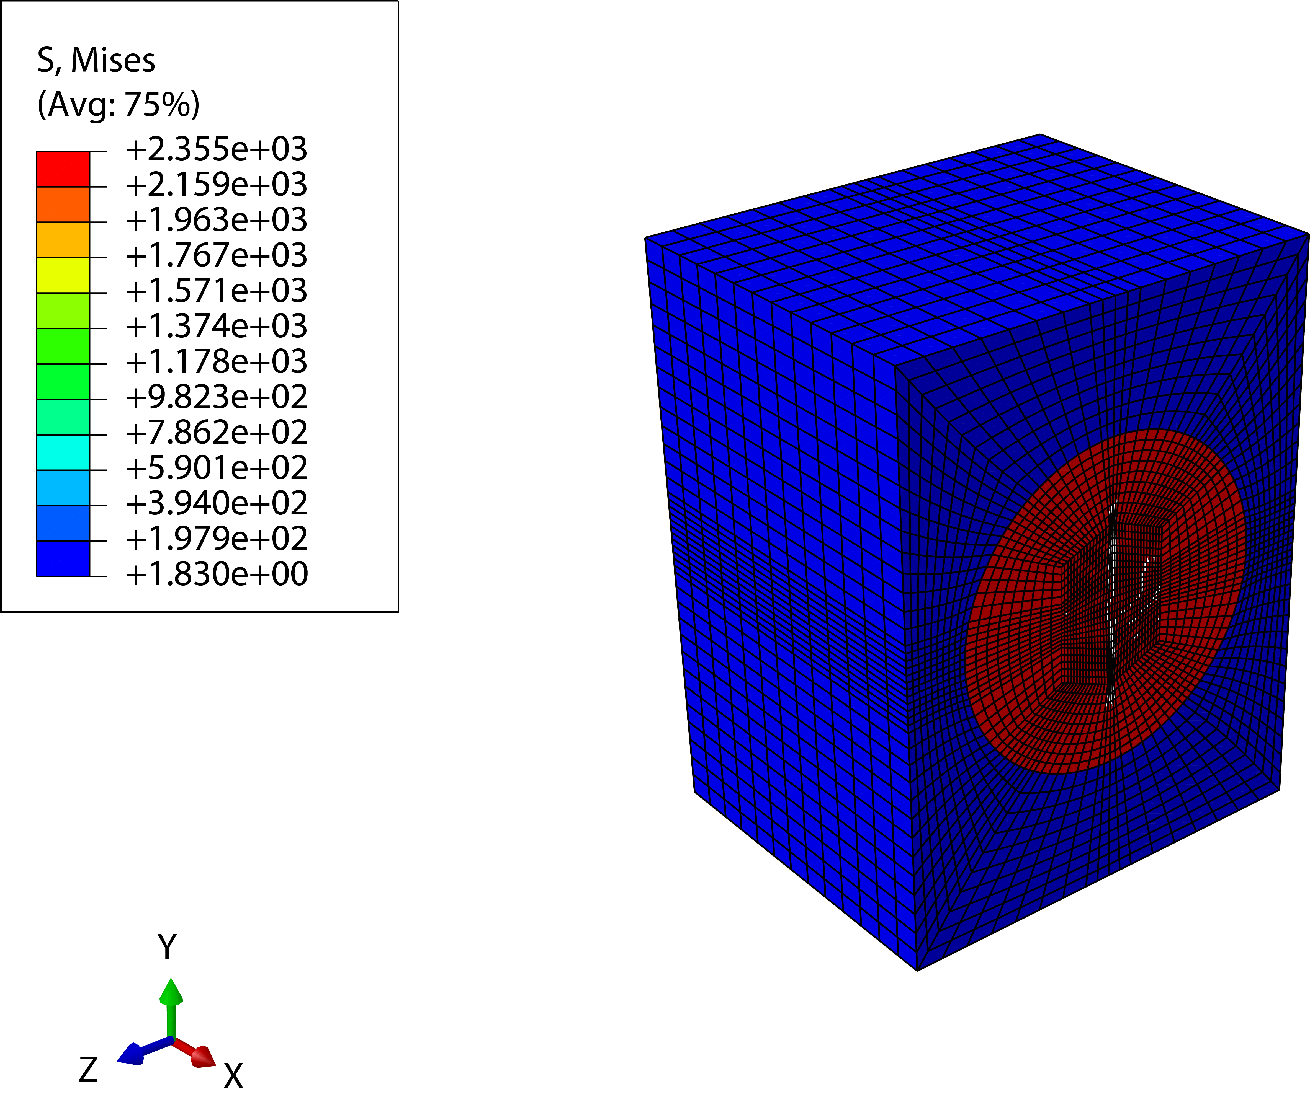
Introduction
​Fiber-reinforced rubber composites → engineered materials → combine elasticity of rubber strength, stiffness of fibers​
Hyperelastic anisotropic material​
Hyperelasticty: Non-linear
Anisotropy: Transverse Isotropy → Preferred direction​
Notes:
detailed finite element analysis of the Representative Volume Element (RVE),

Slide 4
Motivation

Slide 5
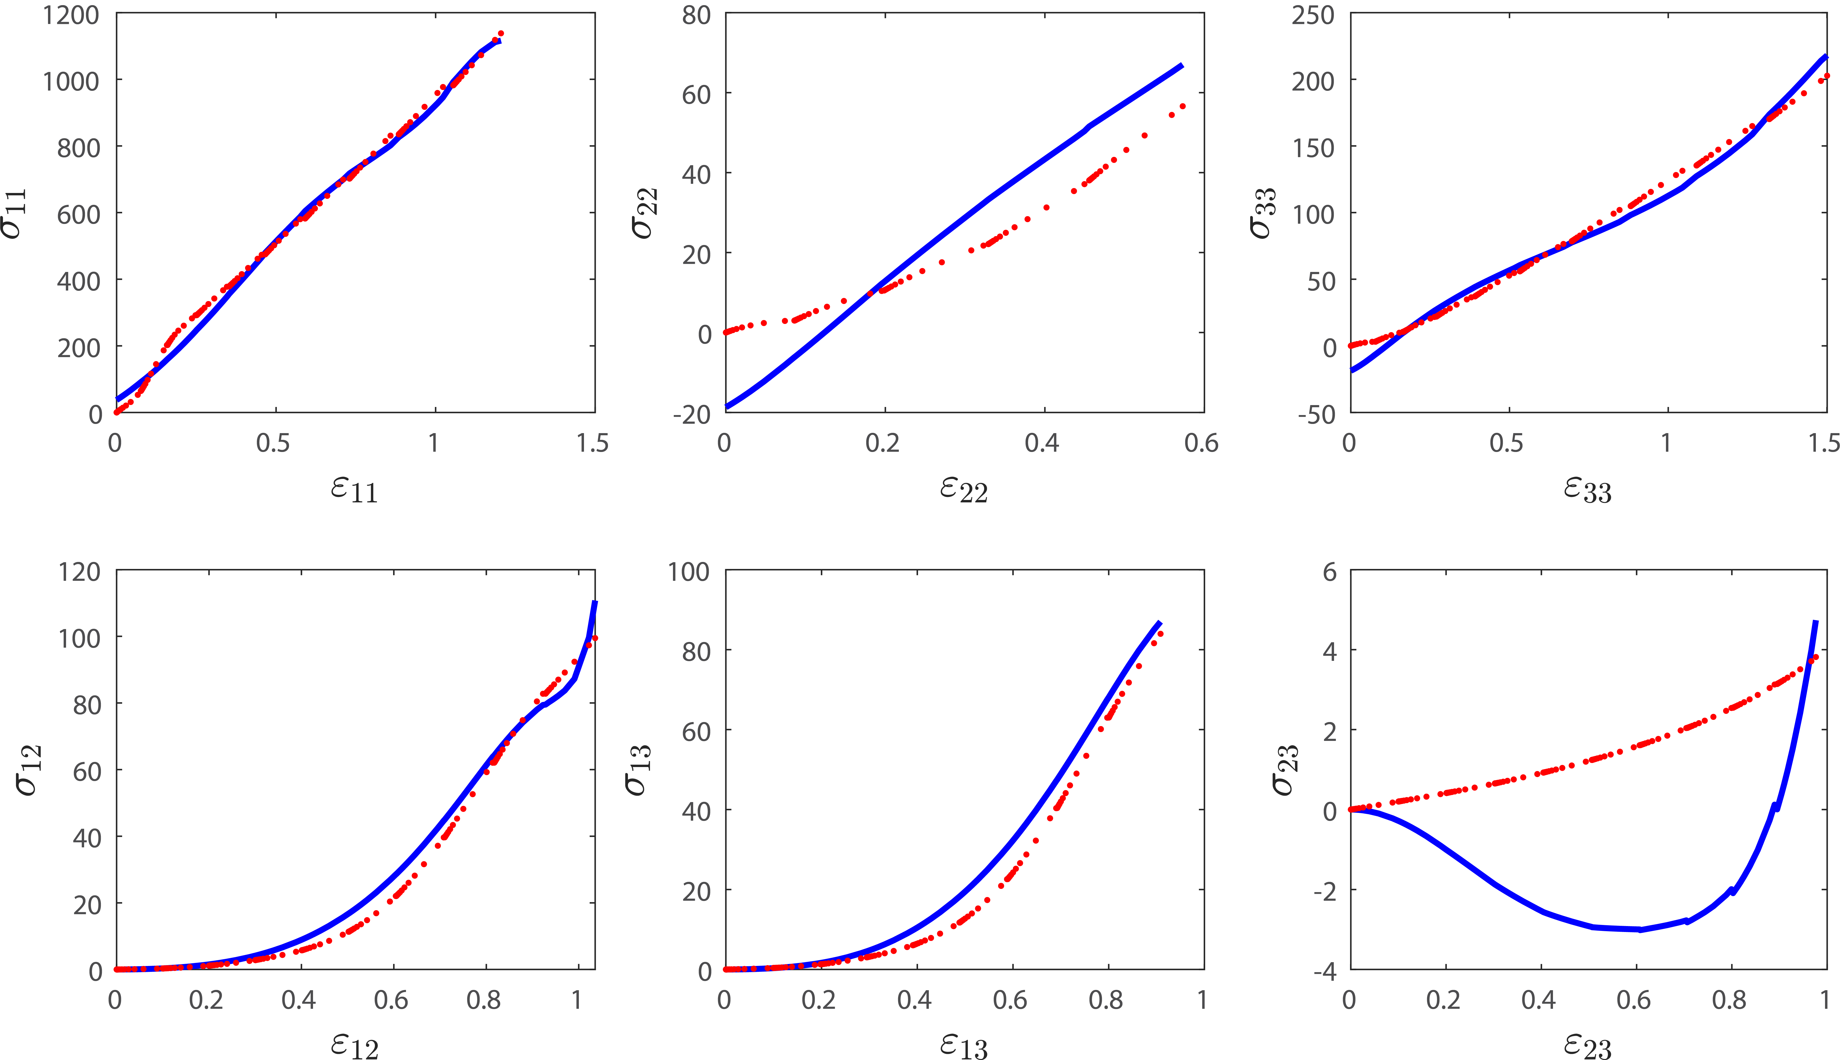
Motivation (continued)
Invariant Based Model 7
- Predicted result
. RVE data

Slide 6
Approach
Incorporating physics into NN and develop general constitutive model approach which can be generalized for any hyperelastic material model
Use of ICNN for convexity

Slide 7

Which Physical Constraints?
Thermodynamic consistency
Objectivity
Convexity
How do we make sure the predicted model satisfied these physical constraints?
If we use strain as input to a FNN and stress as output, would the model be
physically plausible?
The model could predict physically impossible or unrealistic responses
Notes:
To ensure stability of the material model.
Thermodynamic consistency comes from choosing the Hemholtz free energy
Objectivity comes from choosing the invariants instead of strain as input
Growth conditions are not enforced in architecture, but checked manually by looking at how the predicted Psi function behaves
Zero stress is also checked manually
Polyconvexity enforced using ICNN
Principle of Objectivity (Material Frame-Indifference):
The principle of objectivity states that the constitutive relations of a material must be frame-indifferent, meaning they must be independent of any rigid body motions of the reference frame (translations and rotations). This is a fundamental principle in continuum mechanics, ensuring that the material response is the same regardless of the observer's position or orientation. In mathematical terms, the material laws should be invariant under changes of frame, which involve orthogonal transformations when dealing with Euclidean spaces.
Normalization Condition:
The normalization condition is typically a constraint applied to a constitutive model to ensure that it behaves in a physically meaningful way under certain reference conditions. For example, in the context of hyperelasticity, the strain energy function might be normalized such that it is zero in the reference configuration where the material is undeformed. This implies that there is no stored energy in the material when it is not under any external loads or deformations.
Growth Condition:
Growth conditions are constraints on the strain energy function to ensure that the energy grows reasonably with increasing strain, preventing non-physical material responses. In mathematical terms, these conditions ensure that the strain energy function is bounded from below and that it approaches infinity as the strain approaches a critical state that might correspond to material failure. This ensures that the model predicts that it takes an infinite amount of energy to deform a material to an infinite strain, which is a physical expectation.
Polyconvexity:
Polyconvexity is a mathematical condition imposed on the strain energy function of materials to ensure the existence of a minimizer for the total energy and to avoid non-physical local minima in the energy landscape. A function is polyconvex if it can be expressed as a convex function of the deformation gradient, its minors, and the determinant. This condition is stronger than convexity but weaker than quasiconvexity. It's crucial in ensuring the well-posedness of boundary value problems in nonlinear elasticity, and it helps prevent the interpenetration of matter in finite element simulations.
For incompressible materials, the volume does not change during deformation (the determinant of the deformation gradient is one). For incompressible materials, the volume does not change during deformation (the determinant of the deformation gradient is one).

Slide 8

By-design Strategy
Choosing Ψ , the Helmholtz free energy function as output, instead of stress.
fulfill thermodynamics consistency, can enforce convexity, growth conditions, symmetries,
selecting the optimal parameterization of input variables (e.g., using strain invariants instead of the
strain tensor) → fulfills material objectivity
ψ = f(F) or ψ = f(In) → ψ convex
How to achieve convexity?
Notes:
Lack of Normalization: If the normalization condition is not met, the model might predict that the unstressed state of the material has non-zero stress or that the material does not return to its original configuration upon the removal of forces, which is inconsistent with the behavior of most materials.
Pathological Material Responses: Without convexity, the material could exhibit pathological responses such as negative stiffness, where the material offers less resistance to deformation as the load increases, or a multi-valued stress-strain curve, which could imply that the material exhibits multiple stress values for a single strain state.
Instability and Bifurcation: Materials might display unstable behavior, such as sudden jumps from one deformation state to another without a smooth transition, or bifurcation phenomena where small changes in load result in large and unpredictable changes in the deformation.
Phase Separation and Material Failure: Models that do not satisfy these physical constraints might predict uncontrolled phase separation, where the material abruptly changes its properties, or premature material failure, where the material breaks down at stress levels far below its actual breaking point.
Violations of Thermodynamic Laws: A constitutive model that does not respect the laws of thermodynamics might predict that energy is created or destroyed, which would be physically impossible.
Non-physical Stress-Strain Relationship: Without coercivity, the model could predict that the material exhibits finite stress under indefinitely large strains, which is not physically plausible as materials typically stiffen (strain hardening) or fail under large deformations.
Lack of Physical Constraints in Training: Standard FNNs do not inherently understand physical laws; they are purely data-driven models. Without explicitly imposing physical constraints during the training process, there's a significant chance that the network will predict non-physical material behaviors, especially in extrapolation outside the training data range.
By fulfilling the proposed physics constraints by design, the learned models inherently fulfill the physics constraints and are more robust, especially in the data-limited regime.

Slide 9
ICNN: Input Convex Neural Network
Skip through layers
The function f is convex in y provided that: all W^{(z)} 1:k−1 are non-negative gi are convex and non-decreasing.
The function f is convex in y provided that:
all W^{(z)} 1:k−1 are non-negative
gi are convex and non-decreasing.
Notes:
Train, Test, Validation Split: [88,3,9]
Lack of Normalization: If the normalization condition is not met, the model might predict that the unstressed state of the material has non-zero stress or that the material does not return to its original configuration upon the removal of forces, which is inconsistent with the behavior of most materials.
Pathological Material Responses: Without convexity, the material could exhibit pathological responses such as negative stiffness, where the material offers less resistance to deformation as the load increases, or a multi-valued stress-strain curve, which could imply that the material exhibits multiple stress values for a single strain state.
Instability and Bifurcation: Materials might display unstable behavior, such as sudden jumps from one deformation state to another without a smooth transition, or bifurcation phenomena where small changes in load result in large and unpredictable changes in the deformation.
Phase Separation and Material Failure: Models that do not satisfy these physical constraints might predict uncontrolled phase separation, where the material abruptly changes its properties, or premature material failure, where the material breaks down at stress levels far below its actual breaking point.
Violations of Thermodynamic Laws: A constitutive model that does not respect the laws of thermodynamics might predict that energy is created or destroyed, which would be physically impossible.
Non-physical Stress-Strain Relationship: Without coercivity, the model could predict that the material exhibits finite stress under indefinitely large strains, which is not physically plausible as materials typically stiffen (strain hardening) or fail under large deformations.
Lack of Physical Constraints in Training: Standard FNNs do not inherently understand physical laws; they are purely data-driven models. Without explicitly imposing physical constraints during the training process, there's a significant chance that the network will predict non-physical material behaviors, especially in extrapolation outside the training data range.

Slide 10
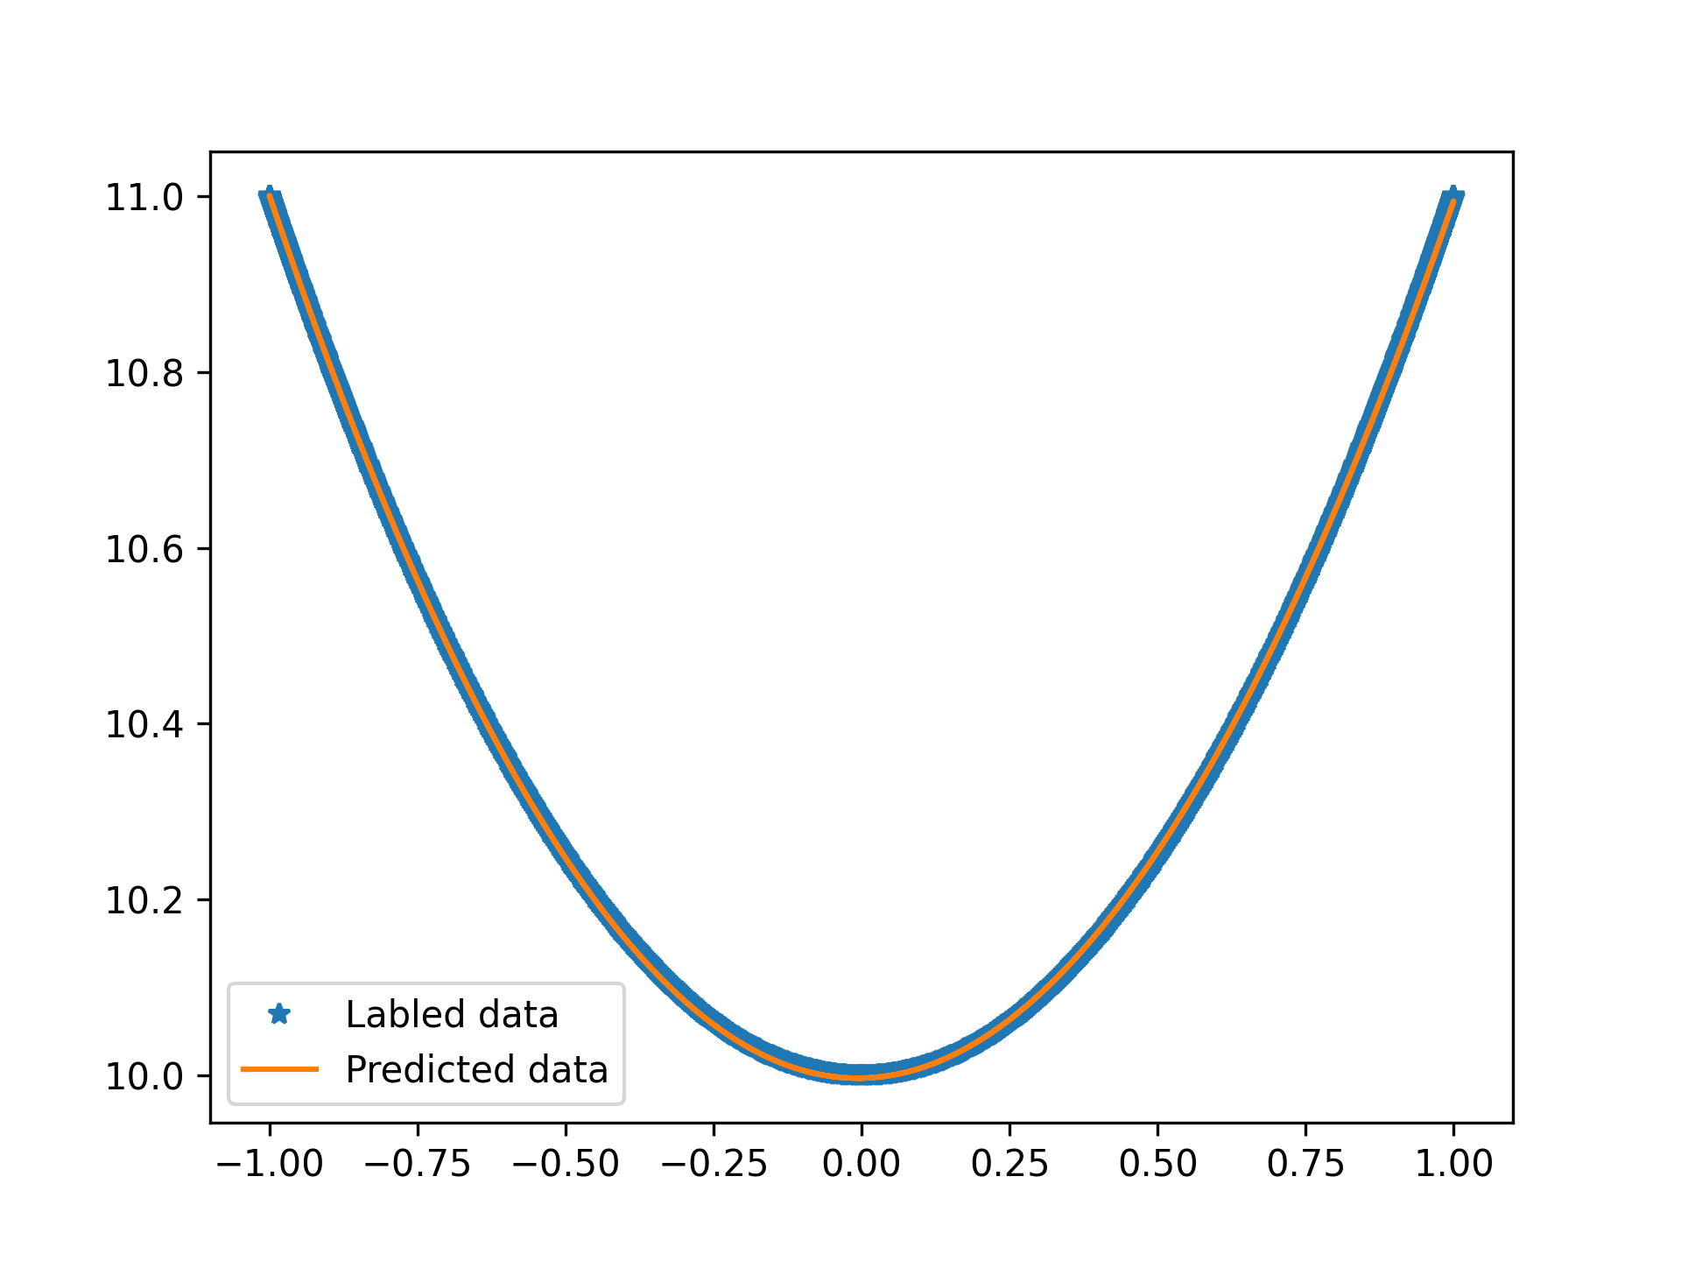
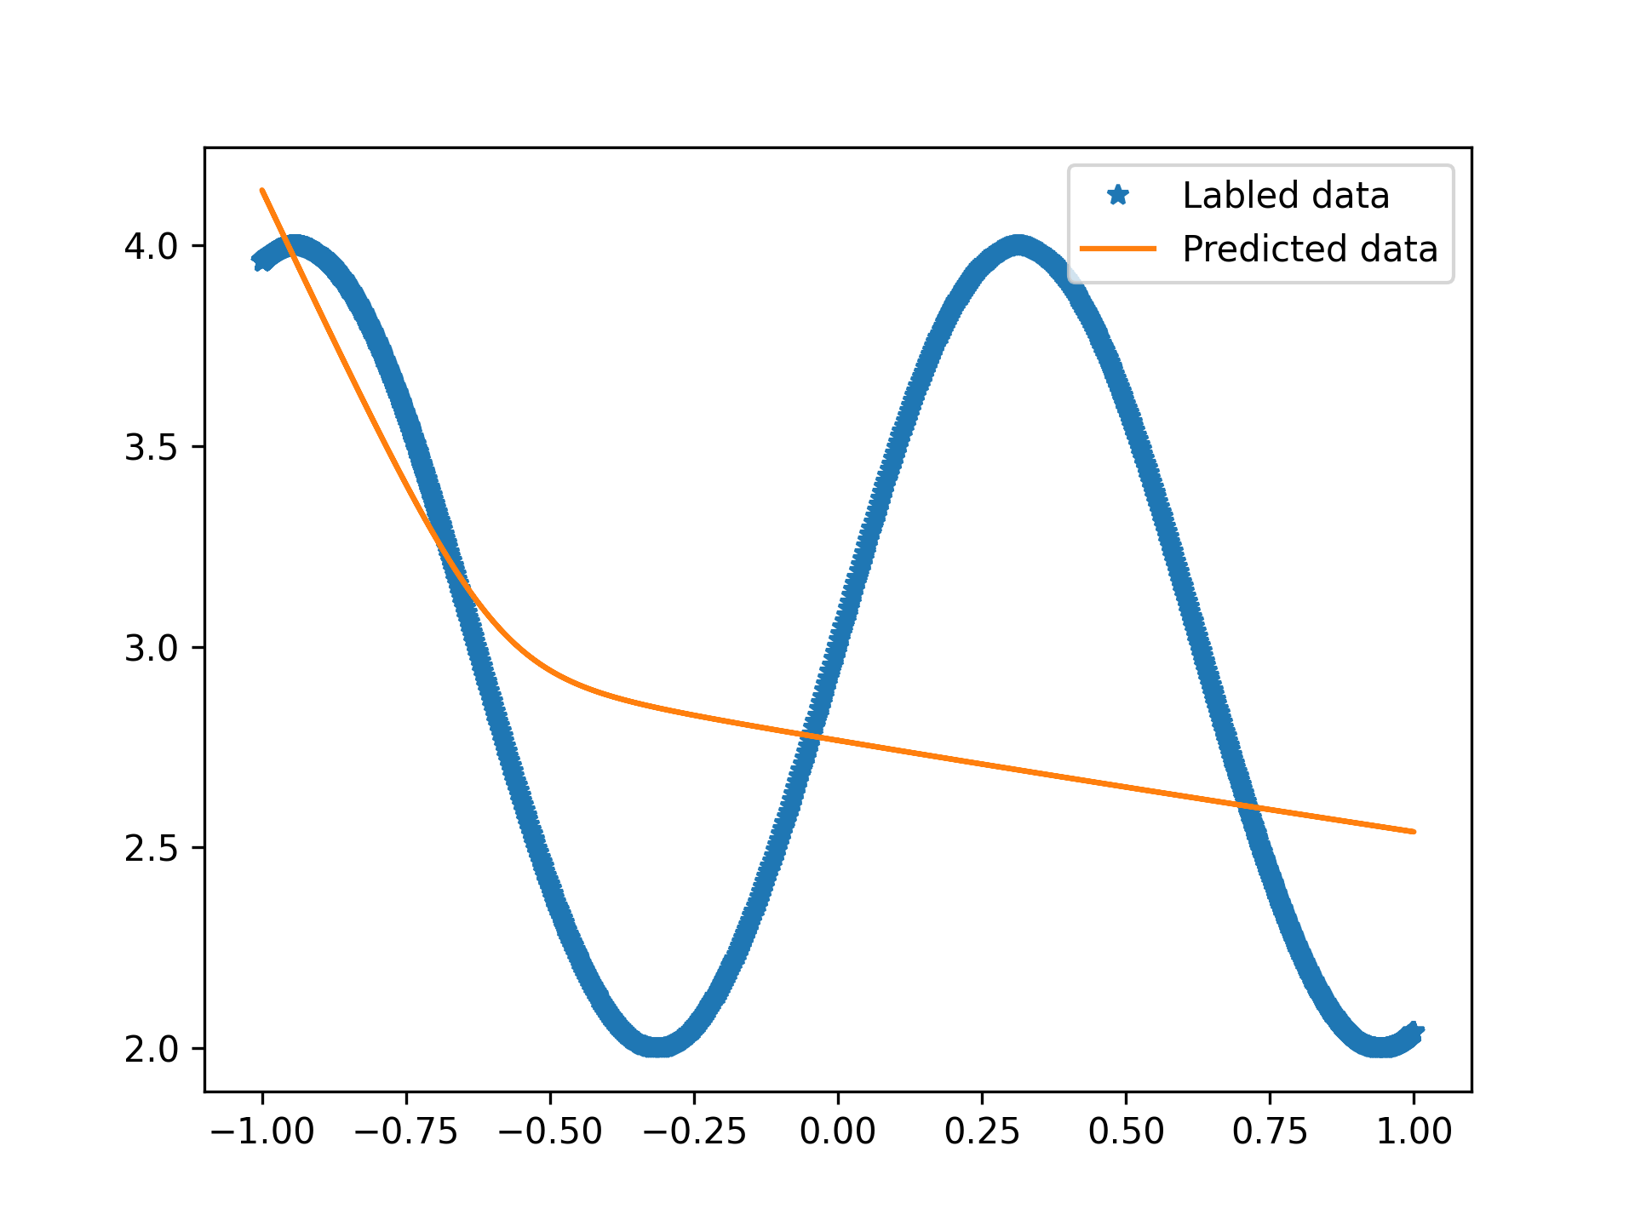
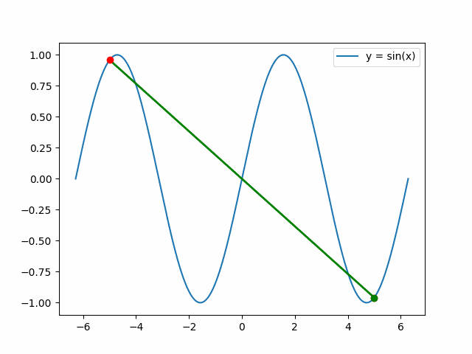
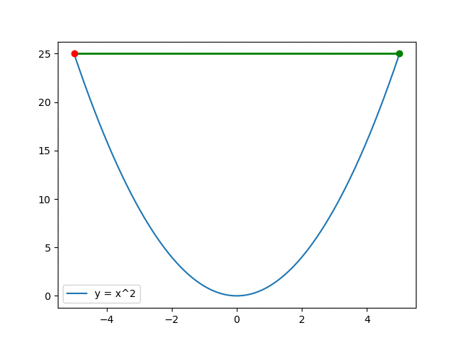
Implementation in ICNN
Dummy Data generated using y= x² . A known convex function.
This Demonstrates that the ICNN’s output will
always be a convex function of the Inputs.
ICNN would fail for non-convex input data. y = sin(x)
The function f is convex in y provided that:
all W^{(z)} 1:k−1 are non-negative
gi are convex and non-decreasing.
Notes:
Lack of Normalization: If the normalization condition is not met, the model might predict that the unstressed state of the material has non-zero stress or that the material does not return to its original configuration upon the removal of forces, which is inconsistent with the behavior of most materials.
Pathological Material Responses: Without convexity, the material could exhibit pathological responses such as negative stiffness, where the material offers less resistance to deformation as the load increases, or a multi-valued stress-strain curve, which could imply that the material exhibits multiple stress values for a single strain state.
Instability and Bifurcation: Materials might display unstable behavior, such as sudden jumps from one deformation state to another without a smooth transition, or bifurcation phenomena where small changes in load result in large and unpredictable changes in the deformation.
Phase Separation and Material Failure: Models that do not satisfy these physical constraints might predict uncontrolled phase separation, where the material abruptly changes its properties, or premature material failure, where the material breaks down at stress levels far below its actual breaking point.
Violations of Thermodynamic Laws: A constitutive model that does not respect the laws of thermodynamics might predict that energy is created or destroyed, which would be physically impossible.
Non-physical Stress-Strain Relationship: Without coercivity, the model could predict that the material exhibits finite stress under indefinitely large strains, which is not physically plausible as materials typically stiffen (strain hardening) or fail under large deformations.
Lack of Physical Constraints in Training: Standard FNNs do not inherently understand physical laws; they are purely data-driven models. Without explicitly imposing physical constraints during the training process, there's a significant chance that the network will predict non-physical material behaviors, especially in extrapolation outside the training data range.

Slide 11
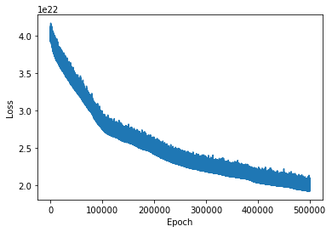
ICNN Results
Notes:
Lack of Normalization: If the normalization condition is not met, the model might predict that the unstressed state of the material has non-zero stress or that the material does not return to its original configuration upon the removal of forces, which is inconsistent with the behavior of most materials.
Pathological Material Responses: Without convexity, the material could exhibit pathological responses such as negative stiffness, where the material offers less resistance to deformation as the load increases, or a multi-valued stress-strain curve, which could imply that the material exhibits multiple stress values for a single strain state.
Instability and Bifurcation: Materials might display unstable behavior, such as sudden jumps from one deformation state to another without a smooth transition, or bifurcation phenomena where small changes in load result in large and unpredictable changes in the deformation.
Phase Separation and Material Failure: Models that do not satisfy these physical constraints might predict uncontrolled phase separation, where the material abruptly changes its properties, or premature material failure, where the material breaks down at stress levels far below its actual breaking point.
Violations of Thermodynamic Laws: A constitutive model that does not respect the laws of thermodynamics might predict that energy is created or destroyed, which would be physically impossible.
Non-physical Stress-Strain Relationship: Without coercivity, the model could predict that the material exhibits finite stress under indefinitely large strains, which is not physically plausible as materials typically stiffen (strain hardening) or fail under large deformations.
Lack of Physical Constraints in Training: Standard FNNs do not inherently understand physical laws; they are purely data-driven models. Without explicitly imposing physical constraints during the training process, there's a significant chance that the network will predict non-physical material behaviors, especially in extrapolation outside the training data range.

Slide 12
Feed Forward NN
Convexity constraint is removed. ψ^{NN} is not necessarily convex w.r.t to all Inputs.
The function f is convex in y provided that:
all W^{(z)} 1:k−1 are non-negative
gi are convex and non-decreasing.
Notes:
Lack of Normalization: If the normalization condition is not met, the model might predict that the unstressed state of the material has non-zero stress or that the material does not return to its original configuration upon the removal of forces, which is inconsistent with the behavior of most materials.
Pathological Material Responses: Without convexity, the material could exhibit pathological responses such as negative stiffness, where the material offers less resistance to deformation as the load increases, or a multi-valued stress-strain curve, which could imply that the material exhibits multiple stress values for a single strain state.
Instability and Bifurcation: Materials might display unstable behavior, such as sudden jumps from one deformation state to another without a smooth transition, or bifurcation phenomena where small changes in load result in large and unpredictable changes in the deformation.
Phase Separation and Material Failure: Models that do not satisfy these physical constraints might predict uncontrolled phase separation, where the material abruptly changes its properties, or premature material failure, where the material breaks down at stress levels far below its actual breaking point.
Violations of Thermodynamic Laws: A constitutive model that does not respect the laws of thermodynamics might predict that energy is created or destroyed, which would be physically impossible.
Non-physical Stress-Strain Relationship: Without coercivity, the model could predict that the material exhibits finite stress under indefinitely large strains, which is not physically plausible as materials typically stiffen (strain hardening) or fail under large deformations.
Lack of Physical Constraints in Training: Standard FNNs do not inherently understand physical laws; they are purely data-driven models. Without explicitly imposing physical constraints during the training process, there's a significant chance that the network will predict non-physical material behaviors, especially in extrapolation outside the training data range.

Slide 13
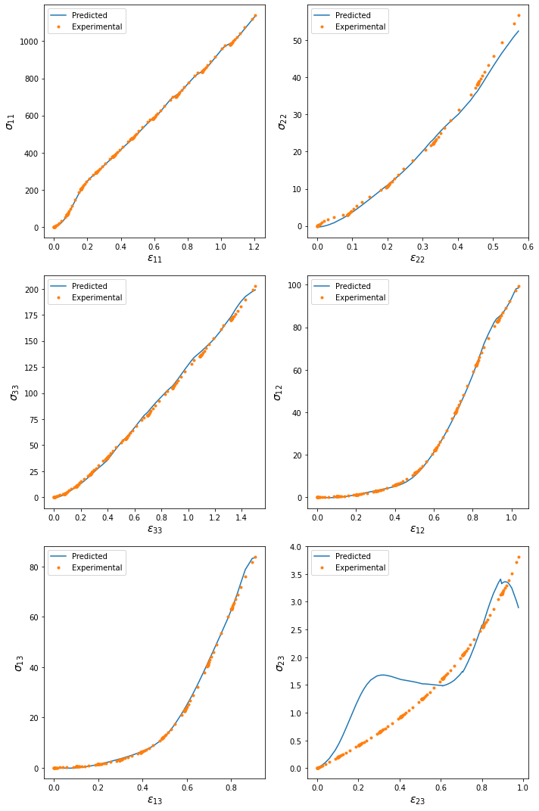
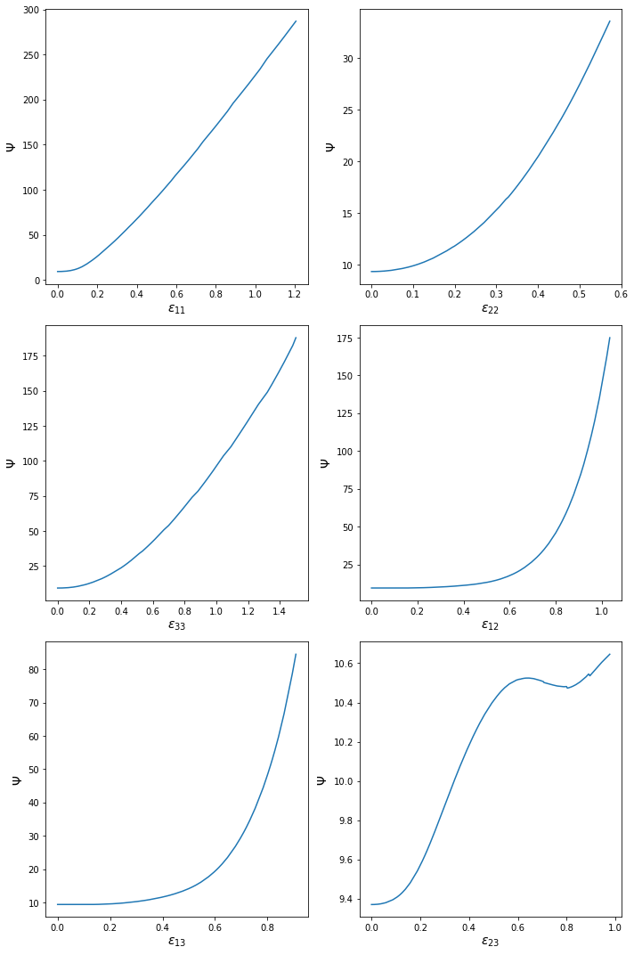
Feed Forward NN Results
- Predicted result
. RVE data
The function f is convex in y provided that:
all W^{(z)} 1:k−1 are non-negative
gi are convex and non-decreasing.
Notes:
Lack of Normalization: If the normalization condition is not met, the model might predict that the unstressed state of the material has non-zero stress or that the material does not return to its original configuration upon the removal of forces, which is inconsistent with the behavior of most materials.
Pathological Material Responses: Without convexity, the material could exhibit pathological responses such as negative stiffness, where the material offers less resistance to deformation as the load increases, or a multi-valued stress-strain curve, which could imply that the material exhibits multiple stress values for a single strain state.
Instability and Bifurcation: Materials might display unstable behavior, such as sudden jumps from one deformation state to another without a smooth transition, or bifurcation phenomena where small changes in load result in large and unpredictable changes in the deformation.
Phase Separation and Material Failure: Models that do not satisfy these physical constraints might predict uncontrolled phase separation, where the material abruptly changes its properties, or premature material failure, where the material breaks down at stress levels far below its actual breaking point.
Violations of Thermodynamic Laws: A constitutive model that does not respect the laws of thermodynamics might predict that energy is created or destroyed, which would be physically impossible.
Non-physical Stress-Strain Relationship: Without coercivity, the model could predict that the material exhibits finite stress under indefinitely large strains, which is not physically plausible as materials typically stiffen (strain hardening) or fail under large deformations.
Lack of Physical Constraints in Training: Standard FNNs do not inherently understand physical laws; they are purely data-driven models. Without explicitly imposing physical constraints during the training process, there's a significant chance that the network will predict non-physical material behaviors, especially in extrapolation outside the training data range.

Slide 14
Hyperparameter Tuning
Hyperparameters
200 combinations, minimize validation loss
hidden_size | number of units in each hidden layer | [3, 6, 9, 12, 15, 20]
num_layers | number of hidden layers | 1-13
lr | learning rate | 1e-5 - 1e-1
'hidden_size': 20, 'num_layers': 4, 'lr': 0.0162971863
Parameters | Model 1 | Model 2
Hidden size | 6 | 20
num_layers | 10 | 4
lr | 0.00056 | 0.016297186309040205
Epoch | 10000 | 10000
Training loss | 131.8243 | 15.3244
Validation loss | 14.1539 | 3.4906
Test loss | 12.496 | 1.184
Notes:
Lack of Normalization: If the normalization condition is not met, the model might predict that the unstressed state of the material has non-zero stress or that the material does not return to its original configuration upon the removal of forces, which is inconsistent with the behavior of most materials.
Pathological Material Responses: Without convexity, the material could exhibit pathological responses such as negative stiffness, where the material offers less resistance to deformation as the load increases, or a multi-valued stress-strain curve, which could imply that the material exhibits multiple stress values for a single strain state.
Instability and Bifurcation: Materials might display unstable behavior, such as sudden jumps from one deformation state to another without a smooth transition, or bifurcation phenomena where small changes in load result in large and unpredictable changes in the deformation.
Phase Separation and Material Failure: Models that do not satisfy these physical constraints might predict uncontrolled phase separation, where the material abruptly changes its properties, or premature material failure, where the material breaks down at stress levels far below its actual breaking point.
Violations of Thermodynamic Laws: A constitutive model that does not respect the laws of thermodynamics might predict that energy is created or destroyed, which would be physically impossible.
Non-physical Stress-Strain Relationship: Without coercivity, the model could predict that the material exhibits finite stress under indefinitely large strains, which is not physically plausible as materials typically stiffen (strain hardening) or fail under large deformations.
Lack of Physical Constraints in Training: Standard FNNs do not inherently understand physical laws; they are purely data-driven models. Without explicitly imposing physical constraints during the training process, there's a significant chance that the network will predict non-physical material behaviors, especially in extrapolation outside the training data range.

Slide 15
Conclusion
Successful implementation of ICNN and FNN with physics
σ23 shows discrepancy with labeled data → matches with thesis conclusion
ICNN implementation with physics needs to be confirmed for some other data
Designed framework → can be used for any hyperelastic, anisotropic material model

Slide 16
THANK YOU

Slide 17
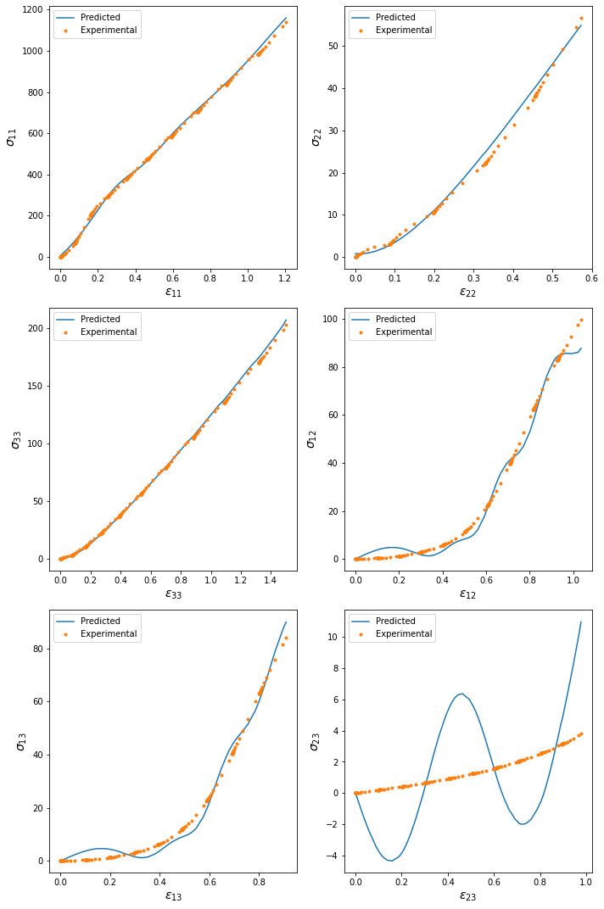
σC
- Predicted result
. RVE data
Notes:
Lack of Normalization: If the normalization condition is not met, the model might predict that the unstressed state of the material has non-zero stress or that the material does not return to its original configuration upon the removal of forces, which is inconsistent with the behavior of most materials.
Pathological Material Responses: Without convexity, the material could exhibit pathological responses such as negative stiffness, where the material offers less resistance to deformation as the load increases, or a multi-valued stress-strain curve, which could imply that the material exhibits multiple stress values for a single strain state.
Instability and Bifurcation: Materials might display unstable behavior, such as sudden jumps from one deformation state to another without a smooth transition, or bifurcation phenomena where small changes in load result in large and unpredictable changes in the deformation.
Phase Separation and Material Failure: Models that do not satisfy these physical constraints might predict uncontrolled phase separation, where the material abruptly changes its properties, or premature material failure, where the material breaks down at stress levels far below its actual breaking point.
Violations of Thermodynamic Laws: A constitutive model that does not respect the laws of thermodynamics might predict that energy is created or destroyed, which would be physically impossible.
Non-physical Stress-Strain Relationship: Without coercivity, the model could predict that the material exhibits finite stress under indefinitely large strains, which is not physically plausible as materials typically stiffen (strain hardening) or fail under large deformations.
Lack of Physical Constraints in Training: Standard FNNs do not inherently understand physical laws; they are purely data-driven models. Without explicitly imposing physical constraints during the training process, there's a significant chance that the network will predict non-physical material behaviors, especially in extrapolation outside the training data range.

Slide 18
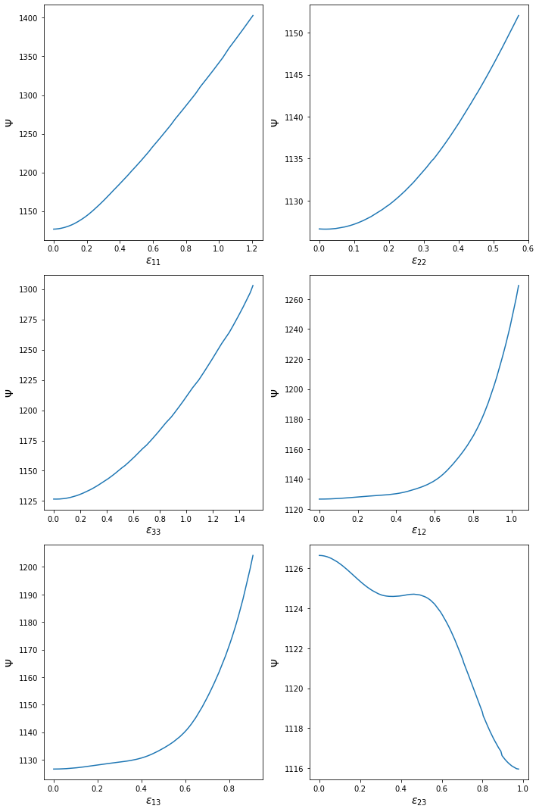
ψ(IN)
Notes:
Lack of Normalization: If the normalization condition is not met, the model might predict that the unstressed state of the material has non-zero stress or that the material does not return to its original configuration upon the removal of forces, which is inconsistent with the behavior of most materials.
Pathological Material Responses: Without convexity, the material could exhibit pathological responses such as negative stiffness, where the material offers less resistance to deformation as the load increases, or a multi-valued stress-strain curve, which could imply that the material exhibits multiple stress values for a single strain state.
Instability and Bifurcation: Materials might display unstable behavior, such as sudden jumps from one deformation state to another without a smooth transition, or bifurcation phenomena where small changes in load result in large and unpredictable changes in the deformation.
Phase Separation and Material Failure: Models that do not satisfy these physical constraints might predict uncontrolled phase separation, where the material abruptly changes its properties, or premature material failure, where the material breaks down at stress levels far below its actual breaking point.
Violations of Thermodynamic Laws: A constitutive model that does not respect the laws of thermodynamics might predict that energy is created or destroyed, which would be physically impossible.
Non-physical Stress-Strain Relationship: Without coercivity, the model could predict that the material exhibits finite stress under indefinitely large strains, which is not physically plausible as materials typically stiffen (strain hardening) or fail under large deformations.
Lack of Physical Constraints in Training: Standard FNNs do not inherently understand physical laws; they are purely data-driven models. Without explicitly imposing physical constraints during the training process, there's a significant chance that the network will predict non-physical material behaviors, especially in extrapolation outside the training data range.

Slide 19
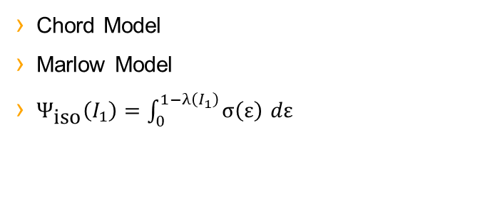
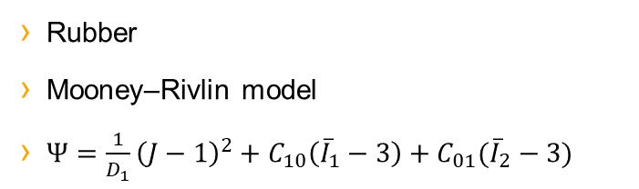
Introduction
Data from Thesis titled “Modeling and numerical simulation of Air spring bellow”​
Data →(ε, σ) → 6 components of strain, 6 components of stress, 6 loading cases

Slide 20
By-design Strategy
2- Thermodynamic consistency → well posedness, stable behavior
1- Frame Invariance/ Objectivity
How to make sure the predicted Psi is convex w.r.t Inputs?
Notes:
Lack of Normalization: If the normalization condition is not met, the model might predict that the unstressed state of the material has non-zero stress or that the material does not return to its original configuration upon the removal of forces, which is inconsistent with the behavior of most materials.
Pathological Material Responses: Without convexity, the material could exhibit pathological responses such as negative stiffness, where the material offers less resistance to deformation as the load increases, or a multi-valued stress-strain curve, which could imply that the material exhibits multiple stress values for a single strain state.
Instability and Bifurcation: Materials might display unstable behavior, such as sudden jumps from one deformation state to another without a smooth transition, or bifurcation phenomena where small changes in load result in large and unpredictable changes in the deformation.
Phase Separation and Material Failure: Models that do not satisfy these physical constraints might predict uncontrolled phase separation, where the material abruptly changes its properties, or premature material failure, where the material breaks down at stress levels far below its actual breaking point.
Violations of Thermodynamic Laws: A constitutive model that does not respect the laws of thermodynamics might predict that energy is created or destroyed, which would be physically impossible.
Non-physical Stress-Strain Relationship: Without coercivity, the model could predict that the material exhibits finite stress under indefinitely large strains, which is not physically plausible as materials typically stiffen (strain hardening) or fail under large deformations.
Lack of Physical Constraints in Training: Standard FNNs do not inherently understand physical laws; they are purely data-driven models. Without explicitly imposing physical constraints during the training process, there's a significant chance that the network will predict non-physical material behaviors, especially in extrapolation outside the training data range.

Slide 21

Helmholtz Free Energy
Most Physical Laws are formulated in terms of energy and potentials. In Continuum Mechanics, Free energy functional holds significance.

Slide 22
Convexity
- Convexity of a Function: A function is convex if a line segment between any two points on its graph does not cross above the graph itself.
- Convex Function: ( y = x² ) is convex as it forms an upward-opening parabola and satisfies the condition that the second derivative is always positive.
- Non-Convex Function: ( y = sin(x) ) is non-convex because its graph oscillates, and the second derivative is not always positive, indicating regions where the function is concave.
- Helmholtz free energy function: convex by definition → a single global minimum → there is a unique deformation state for a given set of loads.
Notes:
Lack of Normalization: If the normalization condition is not met, the model might predict that the unstressed state of the material has non-zero stress or that the material does not return to its original configuration upon the removal of forces, which is inconsistent with the behavior of most materials.
Pathological Material Responses: Without convexity, the material could exhibit pathological responses such as negative stiffness, where the material offers less resistance to deformation as the load increases, or a multi-valued stress-strain curve, which could imply that the material exhibits multiple stress values for a single strain state.
Instability and Bifurcation: Materials might display unstable behavior, such as sudden jumps from one deformation state to another without a smooth transition, or bifurcation phenomena where small changes in load result in large and unpredictable changes in the deformation.
Phase Separation and Material Failure: Models that do not satisfy these physical constraints might predict uncontrolled phase separation, where the material abruptly changes its properties, or premature material failure, where the material breaks down at stress levels far below its actual breaking point.
Violations of Thermodynamic Laws: A constitutive model that does not respect the laws of thermodynamics might predict that energy is created or destroyed, which would be physically impossible.
Non-physical Stress-Strain Relationship: Without coercivity, the model could predict that the material exhibits finite stress under indefinitely large strains, which is not physically plausible as materials typically stiffen (strain hardening) or fail under large deformations.
Lack of Physical Constraints in Training: Standard FNNs do not inherently understand physical laws; they are purely data-driven models. Without explicitly imposing physical constraints during the training process, there's a significant chance that the network will predict non-physical material behaviors, especially in extrapolation outside the training data range.

Slide 23
Convexity
- Mathematically:
- f represents the function in question.
- x and y are any two points in the domain of f .
- λ is a scalar between 0 and 1 , inclusive 0≤λ≤1.
- The inequality states that for a function f to be convex, the value of f at any point on the straight line segment connecting x and y (which is the left-hand side of the inequality) must be less than or equal to the weighted average of the values of f at x and y (which is the right-hand side of the inequality).
Notes:
Lack of Normalization: If the normalization condition is not met, the model might predict that the unstressed state of the material has non-zero stress or that the material does not return to its original configuration upon the removal of forces, which is inconsistent with the behavior of most materials.
Pathological Material Responses: Without convexity, the material could exhibit pathological responses such as negative stiffness, where the material offers less resistance to deformation as the load increases, or a multi-valued stress-strain curve, which could imply that the material exhibits multiple stress values for a single strain state.
Instability and Bifurcation: Materials might display unstable behavior, such as sudden jumps from one deformation state to another without a smooth transition, or bifurcation phenomena where small changes in load result in large and unpredictable changes in the deformation.
Phase Separation and Material Failure: Models that do not satisfy these physical constraints might predict uncontrolled phase separation, where the material abruptly changes its properties, or premature material failure, where the material breaks down at stress levels far below its actual breaking point.
Violations of Thermodynamic Laws: A constitutive model that does not respect the laws of thermodynamics might predict that energy is created or destroyed, which would be physically impossible.
Non-physical Stress-Strain Relationship: Without coercivity, the model could predict that the material exhibits finite stress under indefinitely large strains, which is not physically plausible as materials typically stiffen (strain hardening) or fail under large deformations.
Lack of Physical Constraints in Training: Standard FNNs do not inherently understand physical laws; they are purely data-driven models. Without explicitly imposing physical constraints during the training process, there's a significant chance that the network will predict non-physical material behaviors, especially in extrapolation outside the training data range.

Slide 24
σC
- Predicted result
. RVE data
Notes:
Lack of Normalization: If the normalization condition is not met, the model might predict that the unstressed state of the material has non-zero stress or that the material does not return to its original configuration upon the removal of forces, which is inconsistent with the behavior of most materials.
Pathological Material Responses: Without convexity, the material could exhibit pathological responses such as negative stiffness, where the material offers less resistance to deformation as the load increases, or a multi-valued stress-strain curve, which could imply that the material exhibits multiple stress values for a single strain state.
Instability and Bifurcation: Materials might display unstable behavior, such as sudden jumps from one deformation state to another without a smooth transition, or bifurcation phenomena where small changes in load result in large and unpredictable changes in the deformation.
Phase Separation and Material Failure: Models that do not satisfy these physical constraints might predict uncontrolled phase separation, where the material abruptly changes its properties, or premature material failure, where the material breaks down at stress levels far below its actual breaking point.
Violations of Thermodynamic Laws: A constitutive model that does not respect the laws of thermodynamics might predict that energy is created or destroyed, which would be physically impossible.
Non-physical Stress-Strain Relationship: Without coercivity, the model could predict that the material exhibits finite stress under indefinitely large strains, which is not physically plausible as materials typically stiffen (strain hardening) or fail under large deformations.
Lack of Physical Constraints in Training: Standard FNNs do not inherently understand physical laws; they are purely data-driven models. Without explicitly imposing physical constraints during the training process, there's a significant chance that the network will predict non-physical material behaviors, especially in extrapolation outside the training data range.

Slide 25
ICNN Results
Notes:
Lack of Normalization: If the normalization condition is not met, the model might predict that the unstressed state of the material has non-zero stress or that the material does not return to its original configuration upon the removal of forces, which is inconsistent with the behavior of most materials.
Pathological Material Responses: Without convexity, the material could exhibit pathological responses such as negative stiffness, where the material offers less resistance to deformation as the load increases, or a multi-valued stress-strain curve, which could imply that the material exhibits multiple stress values for a single strain state.
Instability and Bifurcation: Materials might display unstable behavior, such as sudden jumps from one deformation state to another without a smooth transition, or bifurcation phenomena where small changes in load result in large and unpredictable changes in the deformation.
Phase Separation and Material Failure: Models that do not satisfy these physical constraints might predict uncontrolled phase separation, where the material abruptly changes its properties, or premature material failure, where the material breaks down at stress levels far below its actual breaking point.
Violations of Thermodynamic Laws: A constitutive model that does not respect the laws of thermodynamics might predict that energy is created or destroyed, which would be physically impossible.
Non-physical Stress-Strain Relationship: Without coercivity, the model could predict that the material exhibits finite stress under indefinitely large strains, which is not physically plausible as materials typically stiffen (strain hardening) or fail under large deformations.
Lack of Physical Constraints in Training: Standard FNNs do not inherently understand physical laws; they are purely data-driven models. Without explicitly imposing physical constraints during the training process, there's a significant chance that the network will predict non-physical material behaviors, especially in extrapolation outside the training data range.

